Slide 1
Second-generation p-values: equivalence tests, statistical properties, and false discovery rates
Part II
Jeffrey D. Blume,
PhD
Megan H. Murray, almost PhD (July 6th defense)
and
School of Data Science
University of Virginia
Department of Biostatistics
Vanderbilt University

Slide 2
Course Layout
Slides Part I
Introduction and applications
Coding Part I
Slides Part II
Equivalence tests, statistical properties, and false discovery rates
Coding Part II
Questions and Discussion

Slide 3
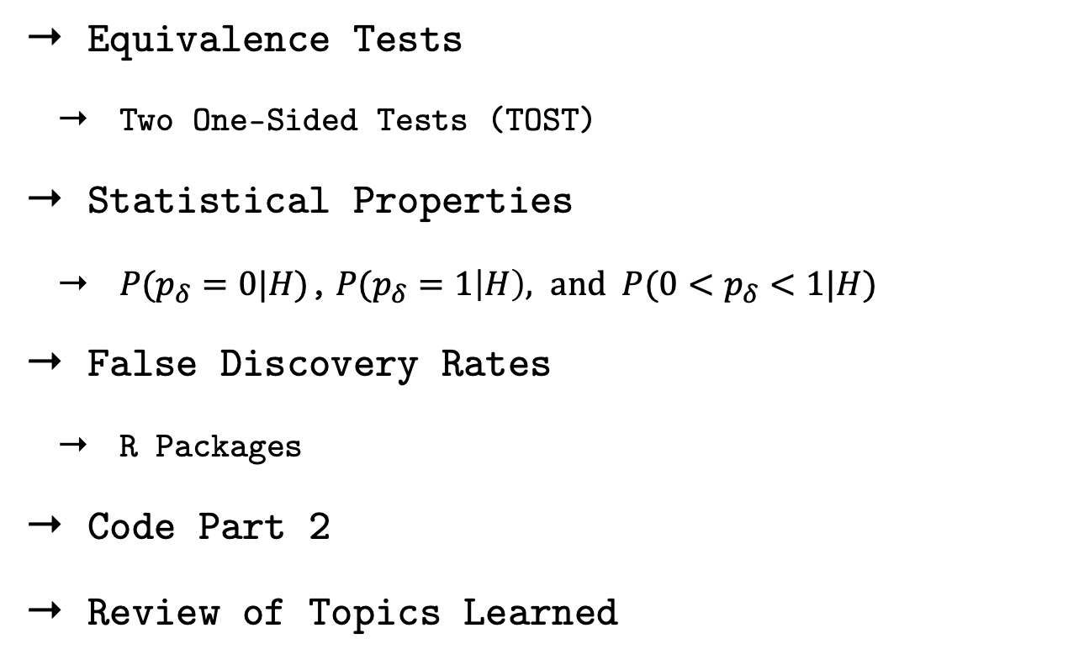
Outline
Equivalence Tests
Two One-Sided Tests (TOST)
Statistical Properties
${P(p}_{δ}=0|H)$,${P(p}_{δ}=1\left|H\right), and {P(0<p}_{δ}<1|H)$
False Discovery Rates
R Packages
Code Part 2
Review of Topics Learned

Slide 4
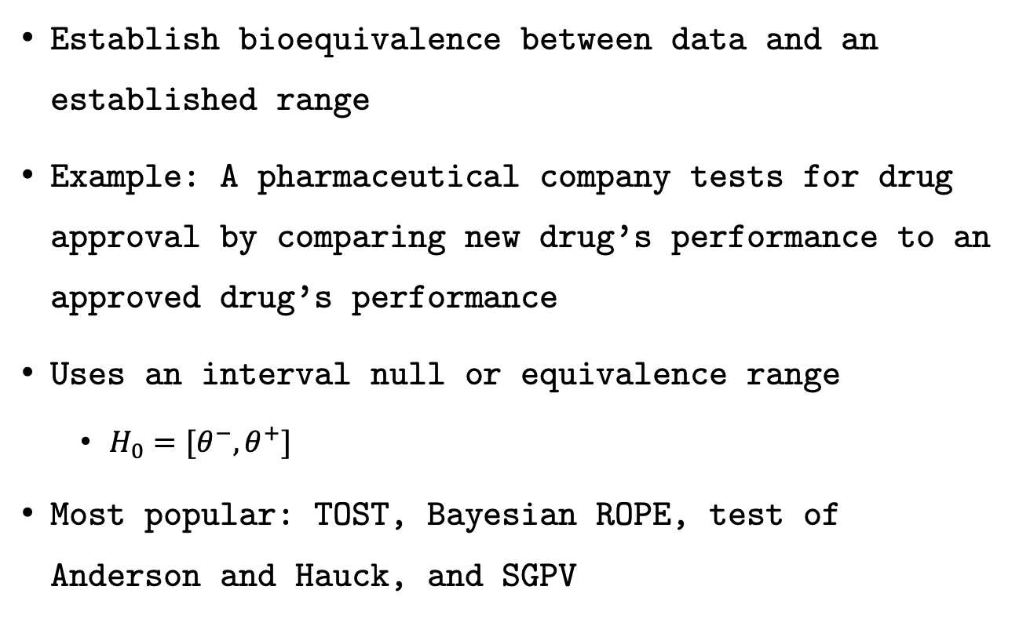
Equivalence Tests
Establish bioequivalence between data and an established range
Example: A pharmaceutical company tests for drug approval by comparing new drug’s performance to an approved drug’s performance
Uses an interval null or equivalence range
$H_{0}=[θ^{−}, θ^{+}]$
Most popular: TOST, Bayesian ROPE, test of Anderson and Hauck, and SGPV

Slide 5
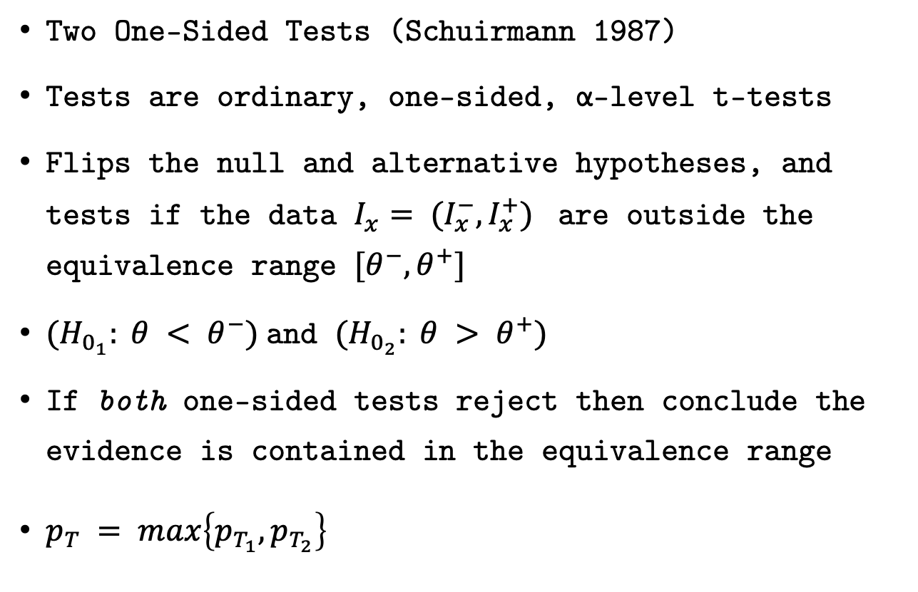
TOST Test
Two One-Sided Tests (Schuirmann 1987)
Tests are ordinary, one-sided, α-level t-tests
Flips the null and alternative hypotheses, and tests if the data $I_{x}= (I_{x}^{−}, I_{x}^{+})$ are outside the equivalence range $[θ^{−}, θ^{+}]$
${(H}_{0_{1}}: θ < θ^{−})$and $(H_{0_{2}}: θ > θ^{+})$
If both one-sided tests reject then conclude the evidence is contained in the equivalence range
$p_{T} =\max\left\{p_{T_{1}},p_{T_{2}}\right\}$

Slide 6
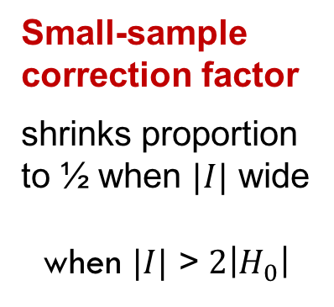
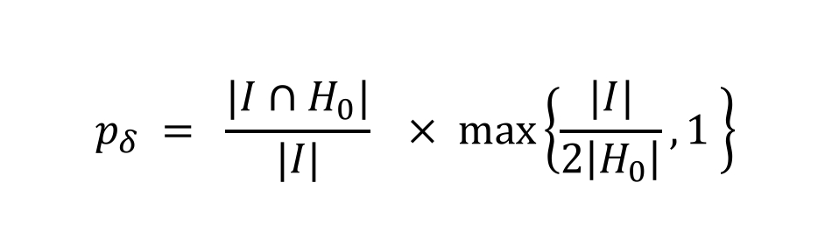
SGPV Definition
Second-generation p-value (SGPV)
$$p_{δ} = \frac{|I∩H_{0}|}{|I|}× max\left\{\frac{|I|}{2\left|H_{0}\right|},1 \right\}$$
Proportion of data-supported hypotheses that are also
null hypotheses
Small-sample correction factor
shrinks proportion to ½ when $|I|$ wide
when $|I|$ > $2\left|H_{0}\right|$

Slide 7
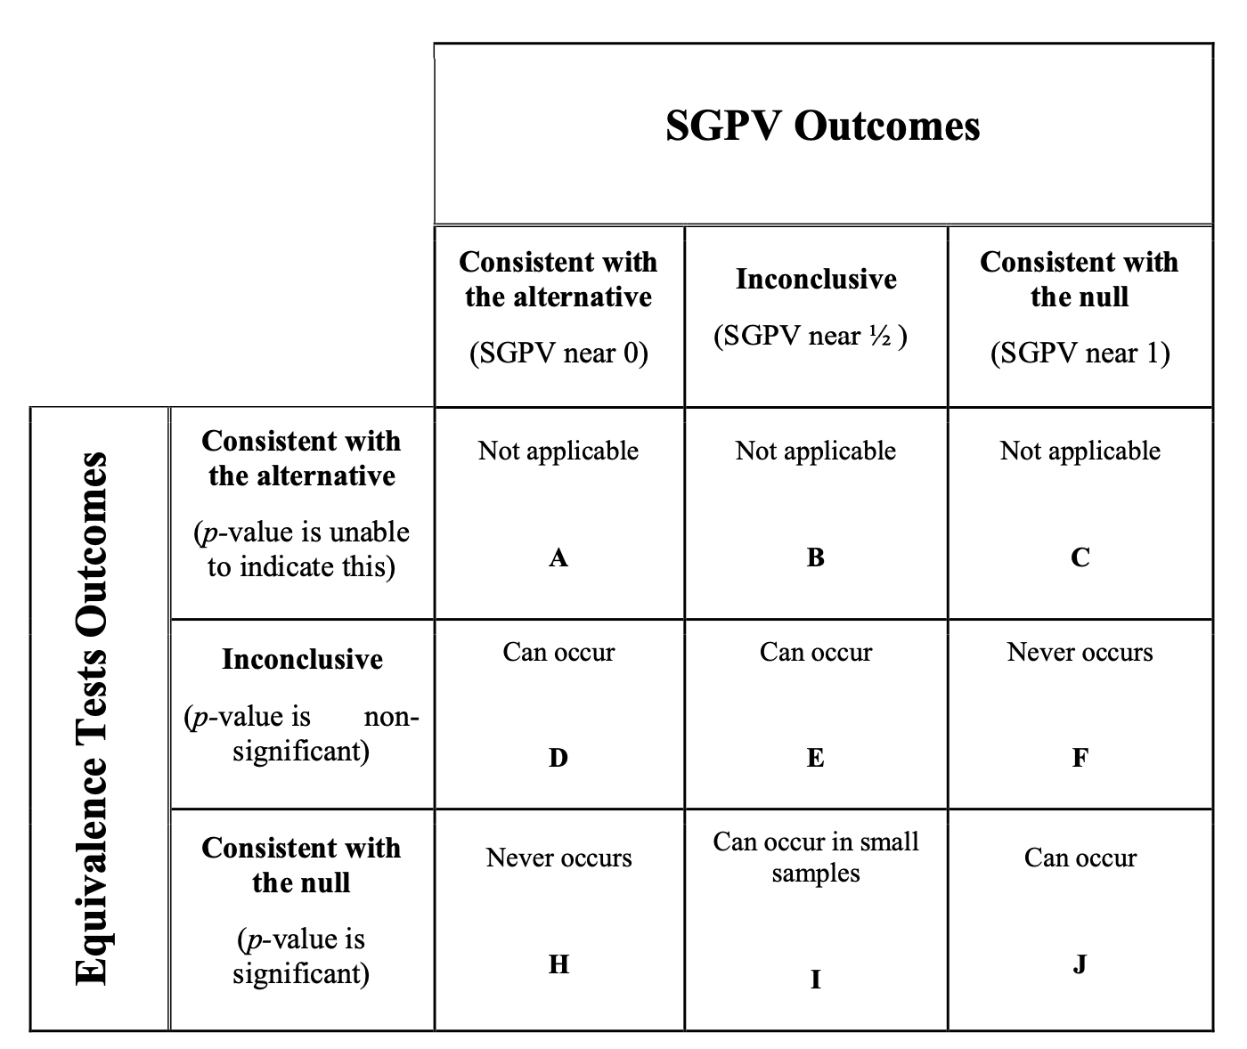
TOST vs. SGPV comparison

Slide 8
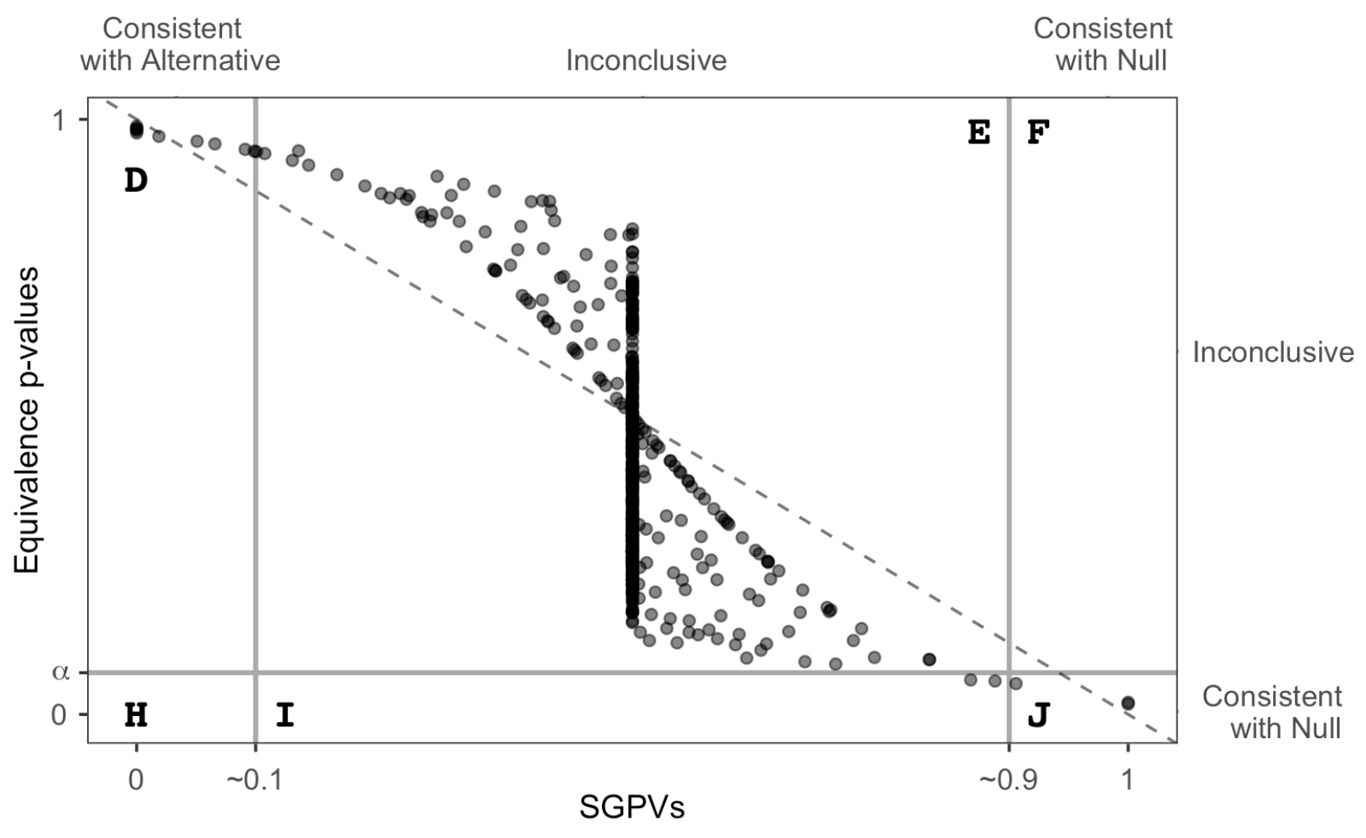
TOST vs. SGPV comparison

Slide 9
TOST vs. SGPV comparison

Slide 10
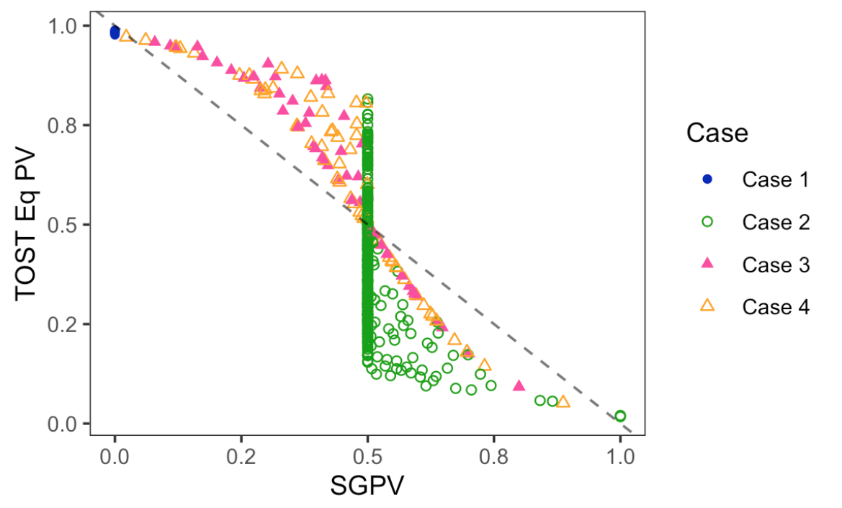
TOST vs. SGPV comparison

Slide 11
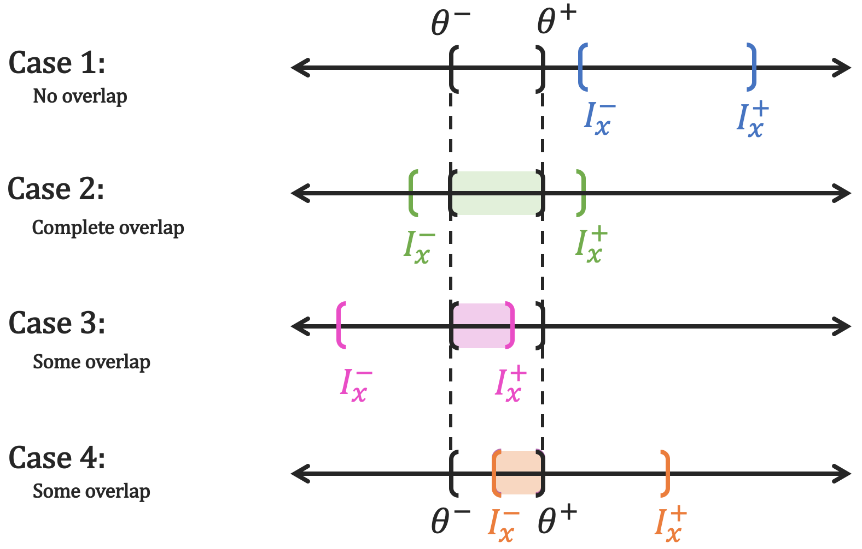
Equivalence Tests

Slide 12
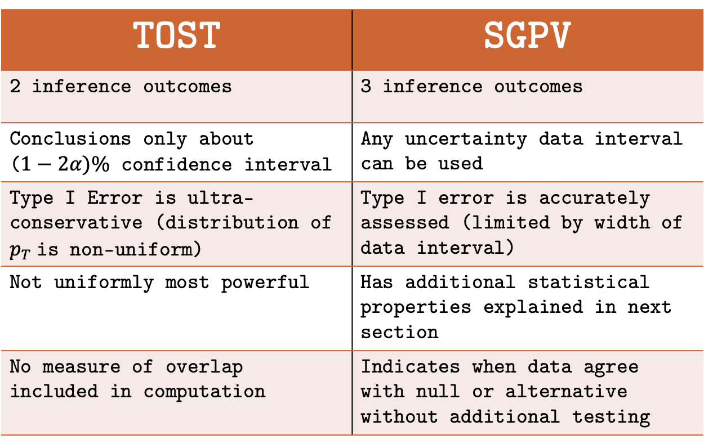
TOST vs. SGPV comparison
TOST | SGPV
2 inference outcomes | 3 inference outcomes
Conclusions only about ($1−2α)\%$ confidence interval | Any uncertainty data interval can be used
Type I Error is ultra-conservative (distribution of $p_{T}$is non-uniform) | Type I error is accurately assessed (limited by width of data interval)
Not uniformly most powerful | Has additional statistical properties explained in next section
No measure of overlap included in computation | Indicates when data agree with null or alternative without additional testing

Slide 13
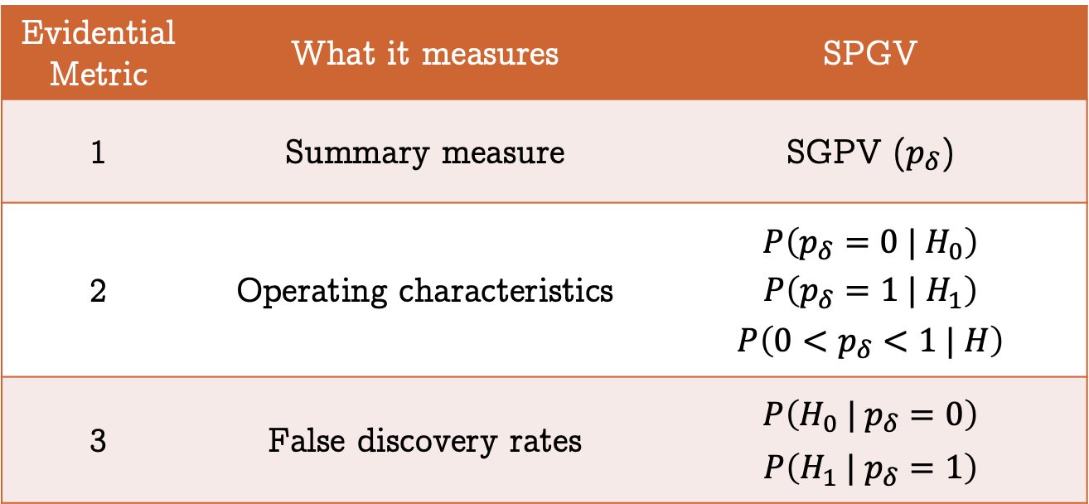
Second-generation p-value
Statistical properties in TAS & PLOS One
Retains strict error control
Evidential Metric | What it measures | SPGV
1 | Summary measure | SGPV ($p_{δ}$)
2 | Operating characteristics | $$P\left(p_{δ}=0 | H_{0}\right)$$ $$P\left(p_{δ}=1 | H_{1}\right)$$ $$P\left(0<p_{δ}<1 | H\right)$$
3 | False discovery rates | $$P\left(H_{0} | p_{δ}=0\right)$$ $$P\left(H_{1} | p_{δ}=1\right)$$

Slide 14
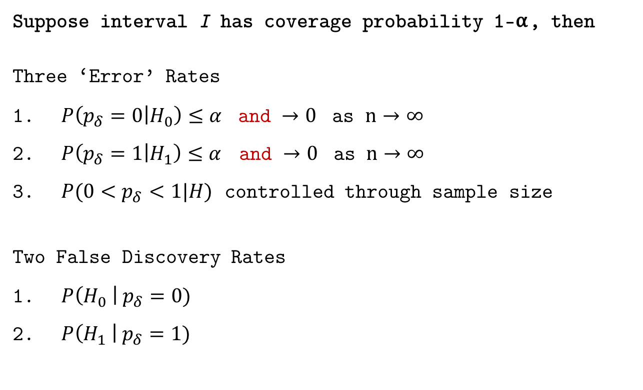
Statistical Properties
Suppose interval I has coverage probability 1-⍺, then
Three ‘Error’ Rates
$P\left(p_{δ}=0 | H_{0}\right)≤α$ and $→0$ as $n→∞$
$P\left(p_{δ}=1 | H_{1}\right)≤α$ and $→0$ as $n→∞$
$P(0<p_{δ}<1|H)$ controlled through sample size
Two False Discovery Rates
$P\left(H_{0} \right| p_{δ}=0)$
$P\left(H_{1} \right| p_{δ}=1)$
Will examine these first
Will graph to illustrate

Slide 15
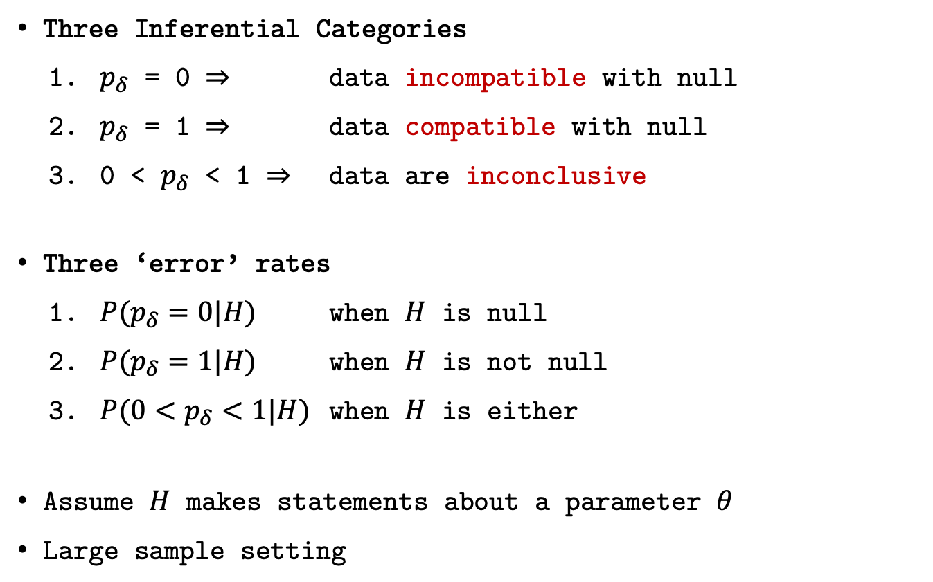
Statistical Properties
Three Inferential Categories
$p_{δ}$ = 0 $⇒$ data incompatible with null
$p_{δ}$ = 1 $⇒$ data compatible with null
0 < $p_{δ}$ < 1 $⇒$ data are inconclusive
Three ‘error’ rates
${P(p}_{δ}=0|H)$ when $H$ is null
${P(p}_{δ}=1|H)$ when $H$ is not null
${P(0<p}_{δ}<1|H)$ when $H$ is either
Assume $H$ makes statements about a parameter $θ$
Large sample setting

Slide 16
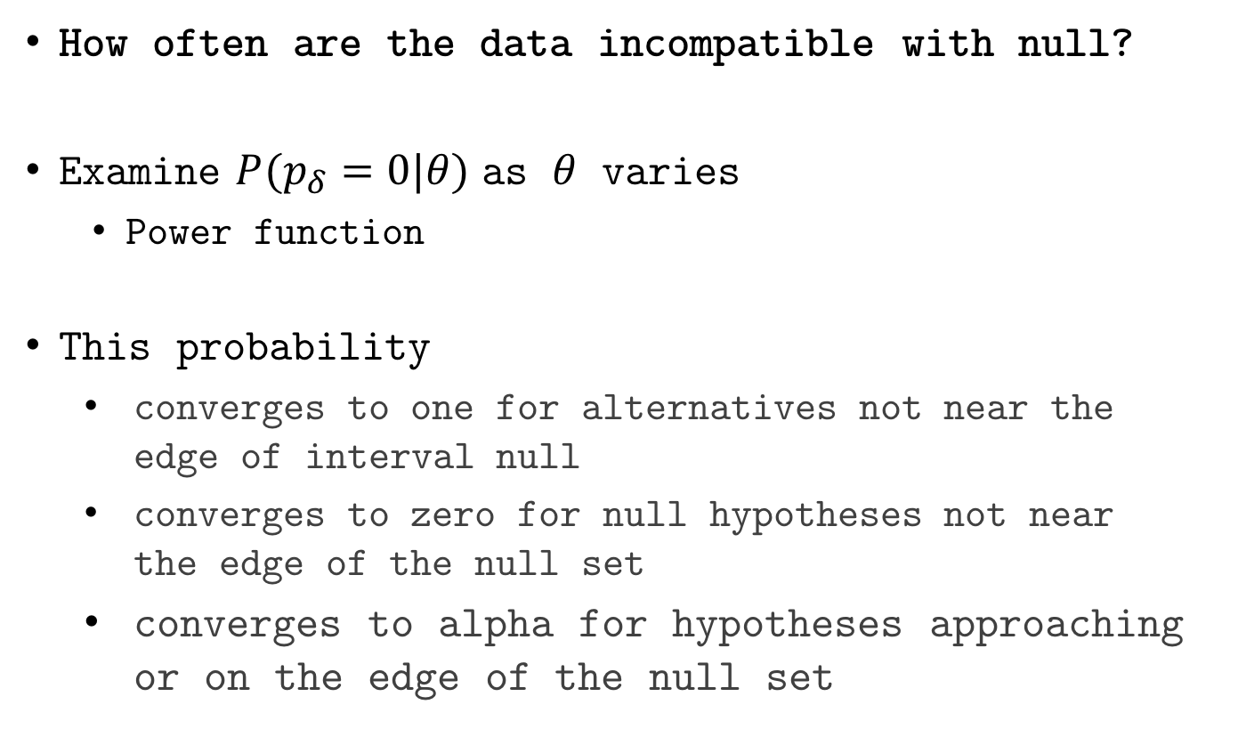
Statistical Properties
How often are the data incompatible with null?
Examine ${P(p}_{δ}=0|θ)$ as $θ$ varies
Power function
This probability
converges to one for alternatives not near the edge of interval null
converges to zero for null hypotheses not near the edge of the null set
converges to alpha for hypotheses approaching or on the edge of the null set

Slide 17
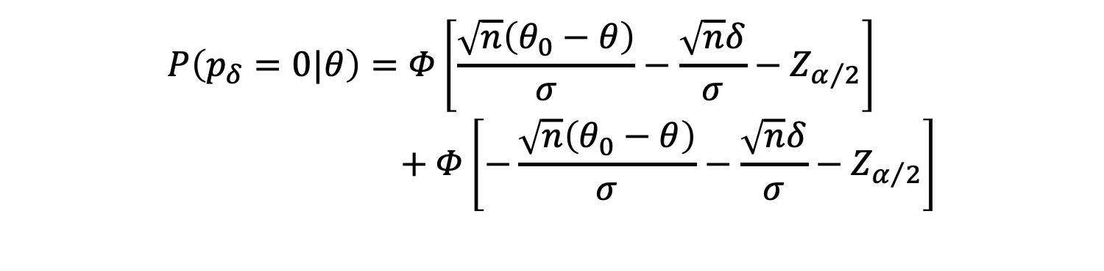
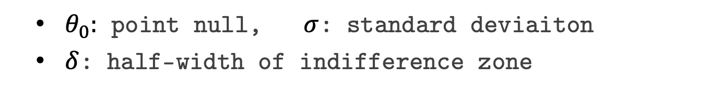
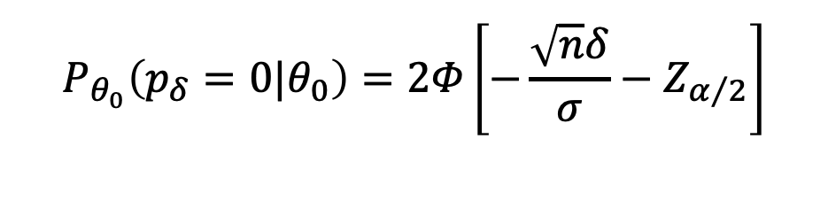
‘Power’ Function
$θ_{0}:$ point null, $σ$: standard deviaiton
$δ$: half-width of indifference zone
$$P\left(p_{δ}=0|θ\right)=Φ\left[\frac{\sqrt{n}\left(θ_{0}−θ\right)}{σ}−\frac{\sqrt{n}δ}{σ}−Z_{α/2}\right] \\ + Φ\left[−\frac{\sqrt{n}\left(θ_{0}−θ\right)}{σ}−\frac{\sqrt{n}δ}{σ}−Z_{α/2}\right]$$
$$P_{θ_{0}}\left(p_{δ}=0|θ_{0}\right)=2Φ\left[−\frac{\sqrt{n}δ}{σ}−Z_{α/2}\right]$$

Slide 18

$$P\left(p_{δ}=0|θ\right)$$

Slide 19
Compare with standard methods
Second-generation p-value vs. Bonferroni correction
Adjusted for {10, 100, 7128} comparisons
Leukemia data example
Remember SGPV are not adjusted for comparisons
Discuss?

Slide 23
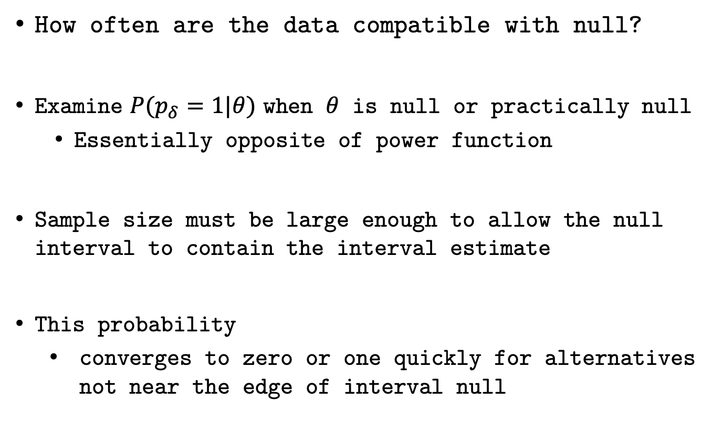
Compatible with Null
How often are the data compatible with null?
Examine ${P(p}_{δ}=1|θ)$ when $θ$ is null or practically null
Essentially opposite of power function
Sample size must be large enough to allow the null interval to contain the interval estimate
This probability
converges to zero or one quickly for alternatives not near the edge of interval null

Slide 24
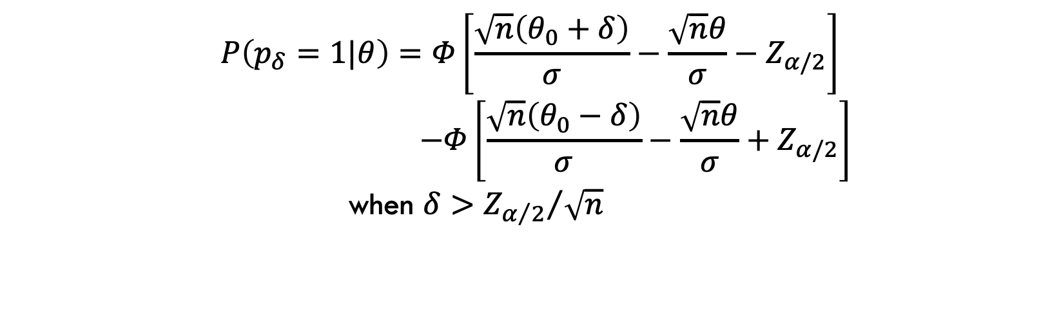
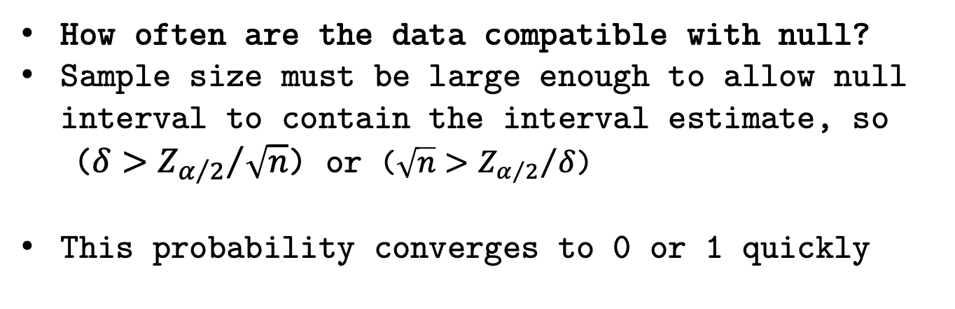
‘Null Power’ Function
How often are the data compatible with null?
Sample size must be large enough to allow null interval to contain the interval estimate, so
($δ>{Z_{α/2}}/{\sqrt{n}}$) or ($\sqrt{n}>{Z_{α/2}}/δ$)
This probability converges to 0 or 1 quickly
$$P\left(p_{δ}=1|θ\right)=Φ\left[\frac{\sqrt{n}\left(θ_{0}+δ\right)}{σ}−\frac{\sqrt{n}θ}{σ}−Z_{α/2}\right]$$
$$−Φ\left[\frac{\sqrt{n}\left(θ_{0}−δ\right)}{σ}−\frac{\sqrt{n}θ}{σ}+Z_{α/2}\right]$$
when $δ>{Z_{α/2}}/{\sqrt{n}}$

Slide 25

$$P\left(p_{δ}=1|θ\right)$$

Slide 26
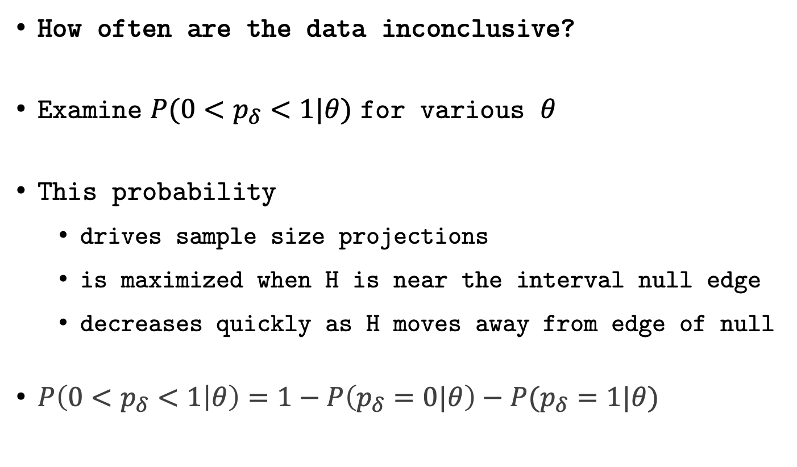
Probability of Inconclusive Data
How often are the data inconclusive?
Examine ${P(0<p}_{δ}<1|θ)$ for various $θ$
This probability
drives sample size projections
is maximized when H is near the interval null edge
decreases quickly as H moves away from edge of null
$P\left(0<p_{δ}<1 | θ\right)=1−P\left(p_{δ}=0|θ\right)−P(p_{δ}=1|θ)$

Slide 27
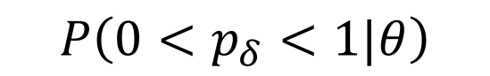
$$P\left(0<p_{δ}<1|θ\right)$$

Slide 28
$$P\left(0<p_{δ}<1|θ\right)$$

Slide 29
Statistical Properties
Suppose interval I has coverage probability 1-⍺, then
Three ‘Error’ Rates
$P\left(p_{δ}=0 | H_{0}\right)≤α$ and $→0$ as $n→∞$
$P\left(p_{δ}=1 | H_{1}\right)≤α$ and $→0$ as $n→∞$
$P(0<p_{δ}<1|H)$ controlled through sample size
Two False Discovery Rates
$P\left(H_{0} \right| p_{δ}=0)$
$P\left(H_{1} \right| p_{δ}=1)$

Slide 30
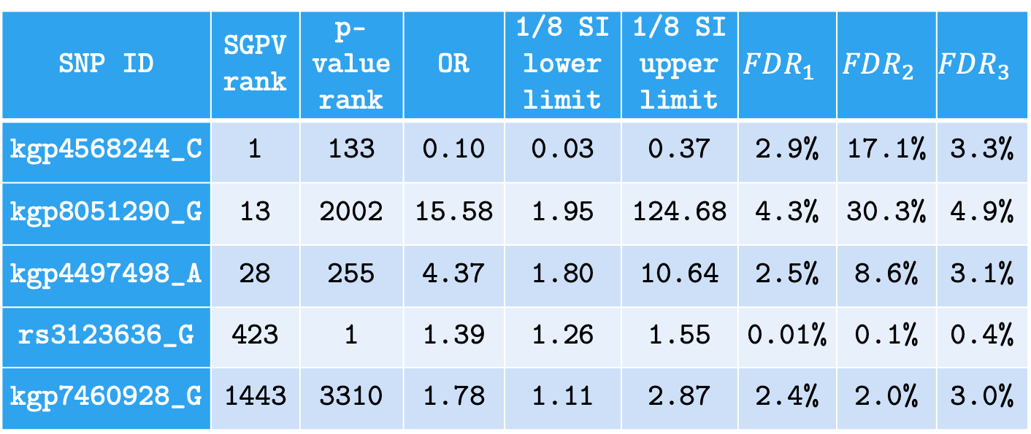
False Discovery Rates
FDR for 5 SGPV=0 findings; computed under various null and alternative configurations (w/ flat prior).
SNP ID | SGPV rank | p-value rank | OR | 1/8 SI lower limit | 1/8 SI upper limit | $$FDR_{1}$$ | $$FDR_{2}$$ | $$FDR_{3}$$
kgp4568244_C | 1 | 133 | 0.10 | 0.03 | 0.37 | 2.9% | 17.1% | 3.3%
kgp8051290_G | 13 | 2002 | 15.58 | 1.95 | 124.68 | 4.3% | 30.3% | 4.9%
kgp4497498_A | 28 | 255 | 4.37 | 1.80 | 10.64 | 2.5% | 8.6% | 3.1%
rs3123636_G | 423 | 1 | 1.39 | 1.26 | 1.55 | 0.01% | 0.1% | 0.4%
kgp7460928_G | 1443 | 3310 | 1.78 | 1.11 | 2.87 | 2.4% | 2.0% | 3.0%
Notes:
For illustration, we computed several flavors of the FDR for 5 SNPs with a SGPV of 0. These are displayed in Table 2. Three versions of the false discovery rate, $FDR=P\left(H_{0} | p_{δ}=0\right)$, were computed. Here $θ$ is the log odds ratio and $\hat{θ}$ is its MLE. $FDR_{1}$ uses the natural point null, $H_{0}:θ=\log\left(1\right)$ with the alternative set to the MLE, $H_{1}:θ=\hat{θ}$. $FDR_{2}$ uses a point null hypothesis that is closer to the null boundary, $H_{0}:θ=\log\left(1.05\right)$, with a prespecified alternative $H_{1}:θ=\log\left(2\right)$. $FDR_{3}$ uses the interval null $H_{0}:θ\sim unif\left[\log\left(0.9\right), \log\left(1/0.9\right)\right]$ and the interval alternative $H_{1}:θ\sim unif\left[{\hat{θ}}_{l},{\hat{θ}}_{u}\right]$ where ${\hat{θ}}_{l}$ and ${\hat{θ}}_{u}$ are the lower and upper bound of the 1/8 SI. FDR computations follow the formulae in Section 5 and Remark E.

Slide 31
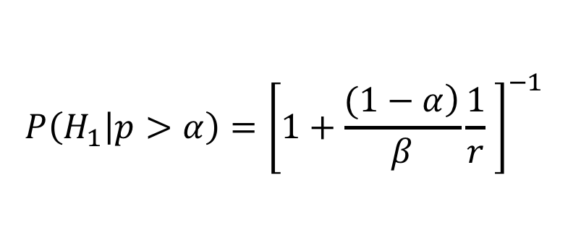
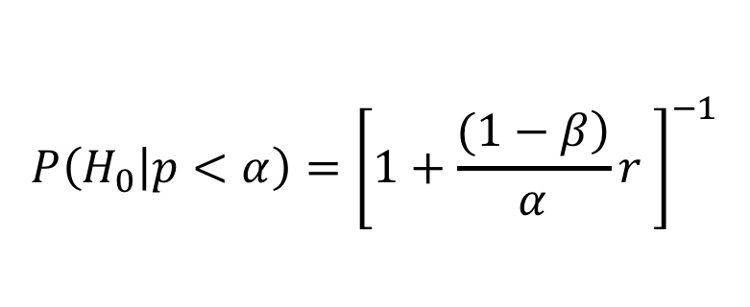
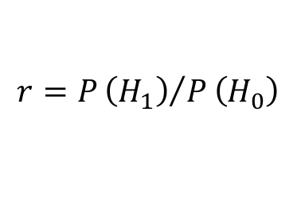
False discovery rates
Impact of ⍺=0.05 vs ⍺=0.05/7128 (7128 comparisons)
False Discovery Rate (FDR)
False Confirmation Rate (FCR)
Error rates
$$P\left(H_{0} | p<α\right)={\left[1+\frac{\left.(1−β\right)}{α}r \right]}^{−1}$$
$$P\left(H_{1} | p>α\right)={\left[1+\frac{\left.(1−α\right)}{β}\frac{1}{r} \right]}^{−1}$$
$$r=P{\left(H_{1}\right)}/P\left(H_{0}\right)$$
Error rates

Slide 32
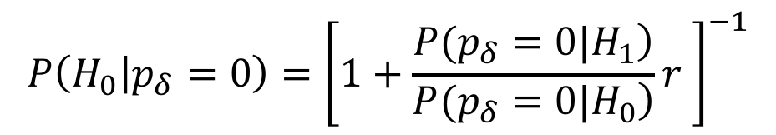
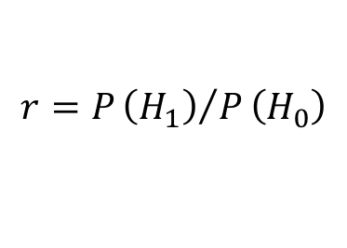
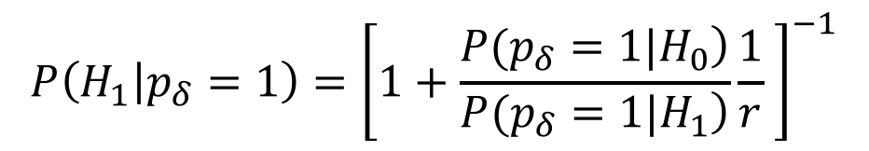
False discovery rates
Second-generation p-values
False Discovery Rate (FDR)
False Confirmation Rate (FCR)
Error Rates
$$P\left(H_{0} | p_{δ}=0\right)={\left[1+\frac{\left.P(p_{δ}=0|H_{1}\right)}{\left.P(p_{δ}=0|H_{0}\right)}r \right]}^{−1}$$
$$P\left(H_{1} | p_{δ}=1\right)={\left[1+\frac{\left.P(p_{δ}=1|H_{0}\right)}{\left.P(p_{δ}=1|H_{1}\right)}\frac{1}{r} \right]}^{−1}$$
$$r=P{\left(H_{1}\right)}/P\left(H_{0}\right)$$
Error Rates

Slide 33
r=1

Slide 34
r=1

Slide 35
r=1

Slide 36
r=1

Slide 37
r=1

Slide 38
r=1

Slide 39
r=1

Slide 40
Remarks
Second-generation p-values…
Has three “Error” rates
Allows Type I and II rate to converge to zero
Control changes of inconclusive results
Controls error rate using science
Reduces the false discovery rate
Anchoring the scale of the effect size…
Eliminates most Type I Errors
Improves scientific translation of statistical model

Slide 41
FDR R Packages
SGPVs
Valerie Welty
sgpv::fdrisk()
This function computes the false discovery risk (sometimes called the "empirical bayes FDR") for a second-generation p-value of 0, or the false confirmation risk for a second-generation p-value of 1.
Raw p-values
FDRestimation::p.fdr()
This function computes FDRs and Method Adjusted p-values.
Methods include: Benjamini-Hochberg, Benjamini-Yeukateli, Bonferroni, Holm, Hochberg, and Sidak.

Slide 42
Time for Code Part 2!

Slide 43
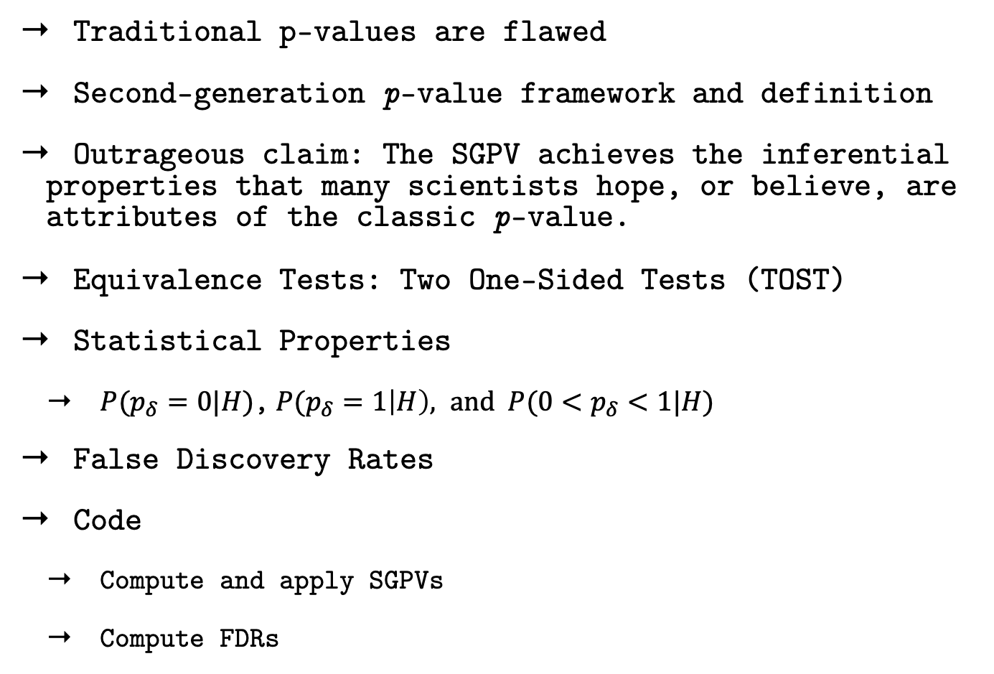
Review of Topics Learned
Traditional p-values are flawed
Second-generation p-value framework and definition
Outrageous claim: The SGPV achieves the inferential properties that many scientists hope, or believe, are attributes of the classic p-value.
Equivalence Tests: Two One-Sided Tests (TOST)
Statistical Properties
${P(p}_{δ}=0|H)$,${P(p}_{δ}=1\left|H\right), and {P(0<p}_{δ}<1|H)$
False Discovery Rates
Code
Compute and apply SGPVs
Compute FDRs

Slide 44
Things we couldn’t get to:
SGPV variable selection (regression modeling) by Yi Zuo
R Package: ProSGPV
Paper: f1000research.com/articles/11-58
Cran vignette: cran.r-project.org/web/packages/ProSGPV/vignettes/linear-vignette.html
Vignette: https://github.com/zuoyi93/ProSGPV/tree/master/vignettes
Adjust for collaborator uncertainty when choosing the null zone
Sequential monitoring by Jonathan Chipman
https://arxiv.org/abs/2204.10678

Slide 45
Acknowledgements
Collaborators
William D. Dupont
Robert A. Greevy
Lucy D’Agostino McGowan
Valerie Welty
Lisa Lin
Jeffrey R. Smith
Yi Zuo
Thomas G. Stewart
Vanderbilt SEDS Lab
Website
www.statisticalevidence.com

